Slide 1
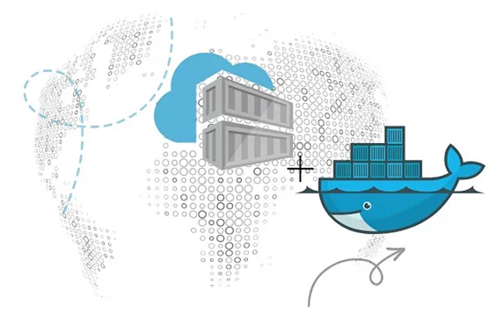
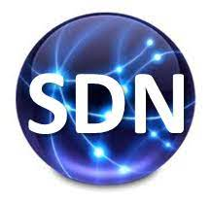
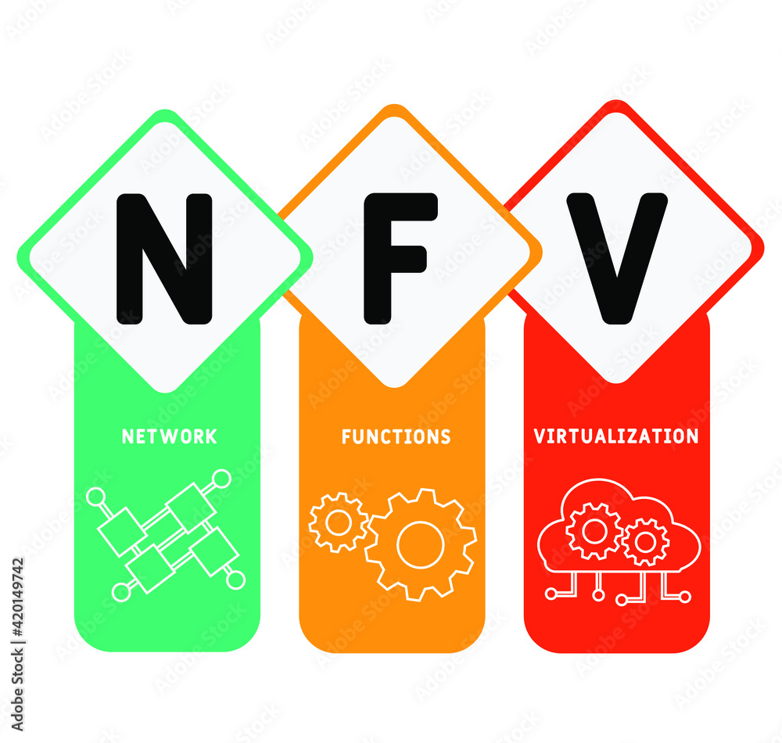
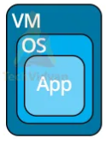
PDS
Computer Vision
Openstack
Cloud Infrastructure
https://github.com/siagianp
https://www.youtube.com/@AmelOline/videos
https://github.com/amelcharolinesgn2/IoT_simulator-mqtt-NodeRed
https://github.com/amelcharolinesgn2/Cloud-Infrastructures
Notes:
https://docs.openstack.org/liberty/install-guide-rdo/overview.html

Slide 2
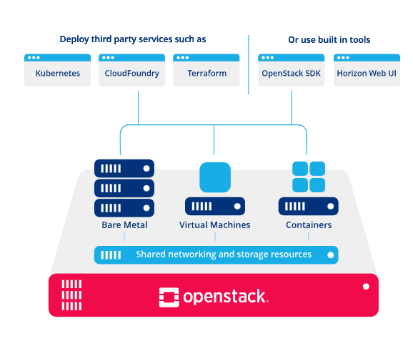
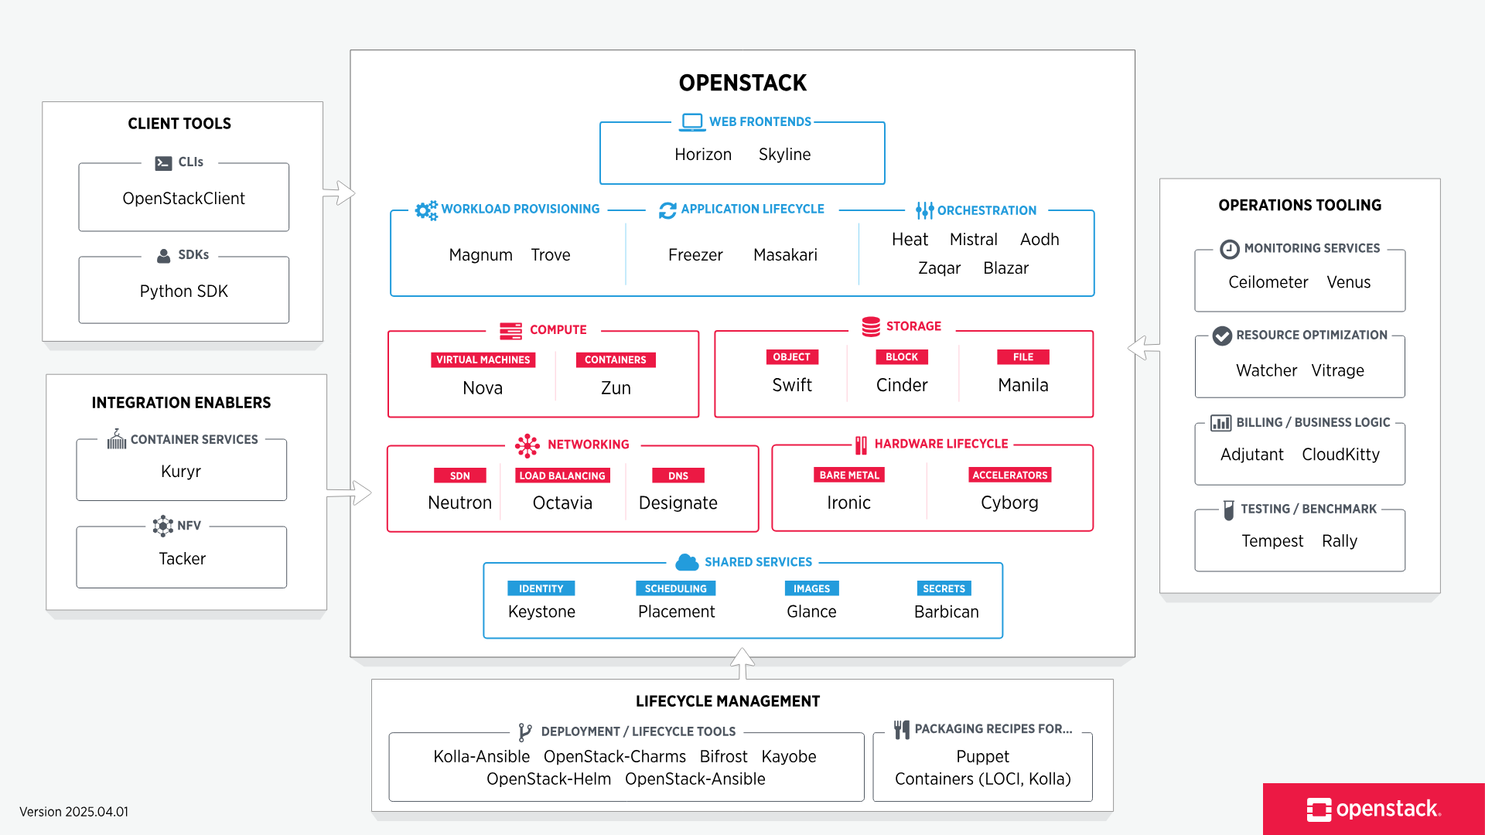
What is OpenStack?
Notes:
https://www.openstack.org/software/
https://docs.openstack.org/liberty/install-guide-rdo/overview.html

Slide 3
lab cloud infrastructure (compute, network, storages, neutron swift,Heat)
Compute (Nova) · Storage (Cinder, Swift, Manila) · Networking (Neutron) · Identity Management (Keystone)
OpenStack services
Service | Project name | Description
Dashboard | Horizon | Provides a web-based self-service portal to interact with underlying OpenStack services, such as launching an instance, assigning IP addresses and configuring access controls.
Compute | Nova | Manages the lifecycle of compute instances in an OpenStack environment. Responsibilities include spawning, scheduling and decommissioning of virtual machines on demand.
Networking | Neutron | Enables Network-Connectivity-as-a-Service for other OpenStack services, such as OpenStack Compute. Provides an API for users to define networks and the attachments into them. Has a pluggable architecture that supports many popular networking vendors and technologies.
 |  | Storage
Object Storage | Swift | Stores and retrieves arbitrary unstructured data objects via a RESTful, HTTP based API. It is highly fault tolerant with its data replication and scale-out architecture. Its implementation is not like a file server with mountable directories. In this case, it writes objects and files to multiple drives, ensuring the data is replicated across a server cluster.
Block Storage | Cinder | Provides persistent block storage to running instances. Its pluggable driver architecture facilitates the creation and management of block storage devices.
 |  | Shared services
Identity service | Keystone | Provides an authentication and authorization service for other OpenStack services. Provides a catalog of endpoints for all OpenStack services.
Image service | Glance | Stores and retrieves virtual machine disk images. OpenStack Compute makes use of this during instance provisioning.
Telemetry | Ceilometer | Monitors and meters the OpenStack cloud for billing, benchmarking, scalability, and statistical purposes.
 |  | Higher-level services
Orchestration | Heat | Orchestrates multiple composite cloud applications by using either the native HOT template format or the AWS CloudFormation template format, through both an OpenStack-native REST API and a CloudFormation-compatible Query API.
Notes:
https://docs.openstack.org/liberty/install-guide-rdo/overview.html
https://docs.openstack.org/liberty/install-guide-rdo/overview.html

Slide 4
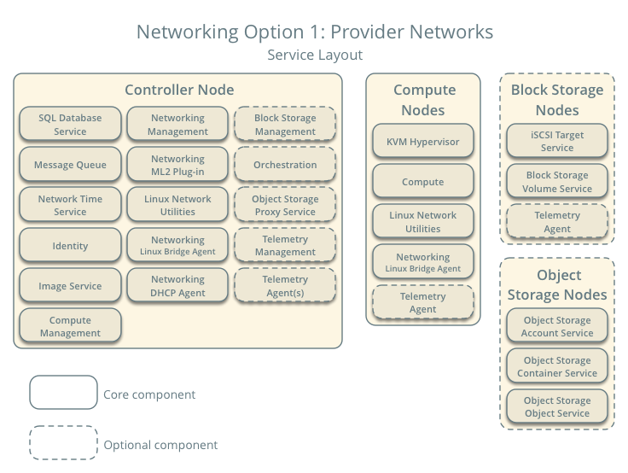
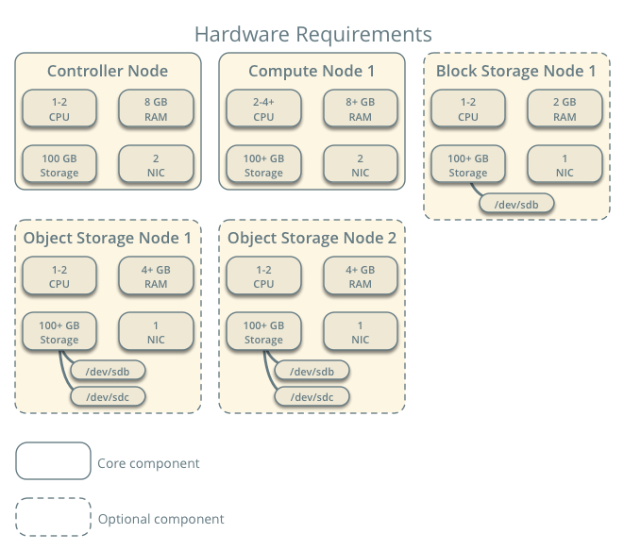
Notes:
https://docs.openstack.org/liberty/install-guide-rdo/overview.html

Slide 5
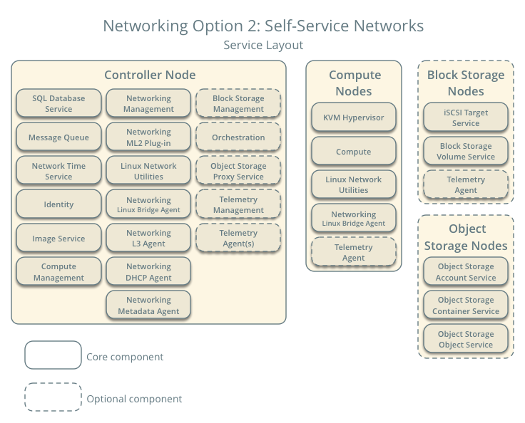

Slide 6
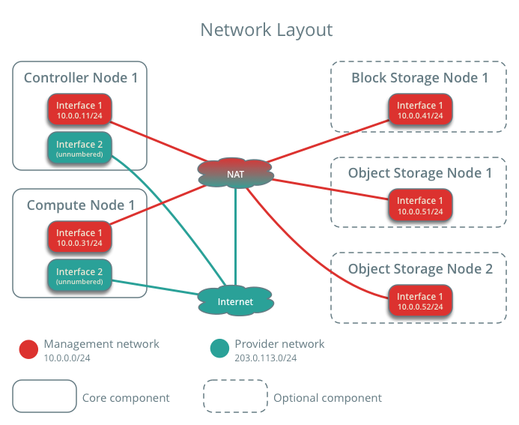
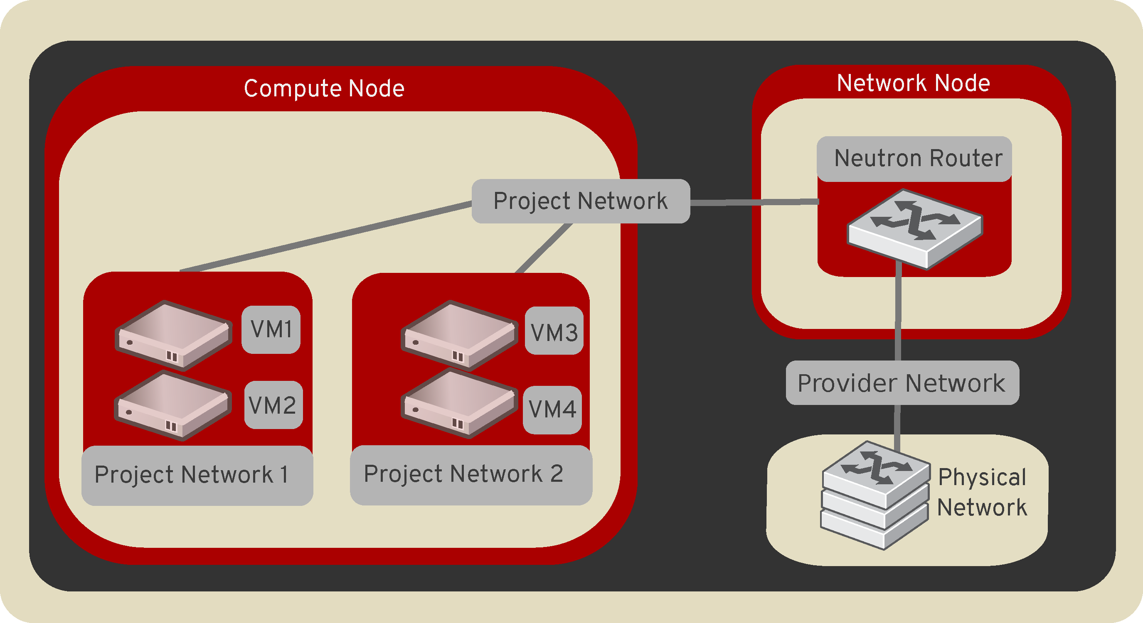
Openstack
https://docs.openstack.org/neutron/pike/install/environment-networking-ubuntu.html
https://docs.openstack.org/neutron/train/admin/intro-os-networking.html
Notes:
https://docs.openstack.org/neutron/pike/install/environment-networking-ubuntu.html
https://docs.openstack.org/neutron/train/admin/intro-os-networking.html
https://docs.redhat.com/en/documentation/red_hat_openstack_platform/10/html/networking_guide/openstack_networking_and_sdn#openstack_networking_and_sdn
https://docs.openstack.org/neutron/pike/install/environment-networking-ubuntu.html
https://docs.openstack.org/neutron/latest/install/controller-install-option2-ubuntu.html
https://docs.redhat.com/en/documentation/red_hat_openstack_platform/10/html/networking_guide/openstack_networking_and_sdn#topics_covered_in_this_book
7. Handbook and Reference
Utama:
Zaigham Mahmood, Ricardo Puttini, and Thomas Erl. Cloud Computing: Concepts, Technology & Architecture. Pearson, 2013
Lizhe Wang, Rajiv Ranjan, Jinjun Chen, and Boualem Benatallah. Cloud Computing: Methodology, Systems, and Application. CRC Press, 2017
Pendukung:
Kief Morris. Infrastructure as a Code: Dynamic System for the Cloud Age, 2nd Edition. O’Reilly, 2021
Stephen Baron. AWS: The Complete Beginner’s Guide. 2020
Adney Ainsley. Google Cloud Platform. 2020
https://docs.docker.com/
https://kubernetes.io/docs/home/
https://opentofu.org/docs/
8. Tools
VirtualBox / VMWare
Docker
Kubernetes
openTofu
Prometheus
Grafana
Sealed Secrets

Slide 7
OpenStack Installation Tutorial for Ubuntu
+=============================+
| |
| COMPUTE-1 |
| public: 10.10.10.101 +-------+
| private: 10.10.11.101 +-----+ |
| management: 10.10.12.101 +---+ | |
| LVM - cinder-volumes | | | |
| | | | |
+=============================+ | | | +===+ +=============================+
| | +----------+ | | |
| +------------+ s | | CONTROLLER |
+--------------+ w +------------+ public: 10.10.10.103 |
| i +------------+ private: 10.10.11.103 |
| t +------------+ management: 10.10.12.103 |
+--------------+ c | | MariaDB + RabbitMQ |
| +------------+ h | | Open vSwitch |
| | +----------+ | | |
+=============================+ | | | +===+ +=============================+
| | | | |
| COMPUTE-2 | | | |
| public: 10.10.10.102 +---+ | |
| private: 10.10.11.102 +-----+ |
| management: 10.10.12.102 +-------+
| LVM - cinder-volumes |
| |
+=============================+
https://github.com/OrhanKupusoglu/openstack-newton
Notes:
https://github.com/OrhanKupusoglu/openstack-newton

Slide 8
+=============================+
| |
| COMPUTE-1 |
| public: 10.10.10.101 +-------+
| private: 10.10.11.101 +-----+ |
| management: 10.10.12.101 +---+ | |
| LVM - cinder-volumes | | | |
| | | | |
+=============================+ | | | +===+ +=============================+
| | +----------+ | | |
| +------------+ s | | CONTROLLER |
+--------------+ w +------------+ public: 10.10.10.103 |
| i +------------+ private: 10.10.11.103 |
| t +------------+ management: 10.10.12.103 |
+--------------+ c | | MariaDB + RabbitMQ |
| +------------+ h | | Open vSwitch |
| | +----------+ | | |
+=============================+ | | | +===+ +=============================+
| | | | |
| COMPUTE-2 | | | |
| public: 10.10.10.102 +---+ | |
| private: 10.10.11.102 +-----+ |
| management: 10.10.12.102 +-------+
| LVM - cinder-volumes |
| |
+=============================+

Slide 9
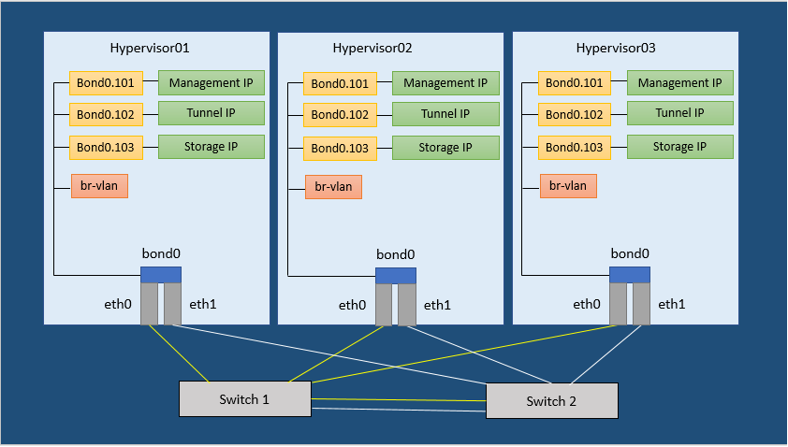
Virtualization
VSwitch
https://platform9.com/docs/openstack-docs/openstack/preparing-ubuntu-preparing-ubuntu-server-for-neutron
Notes:
https://platform9.com/docs/openstack-docs/openstack/preparing-ubuntu-preparing-ubuntu-server-for-neutron
https://platform9.com/docs/openstack-docs/openstack/virtual-machines-instances

Slide 10
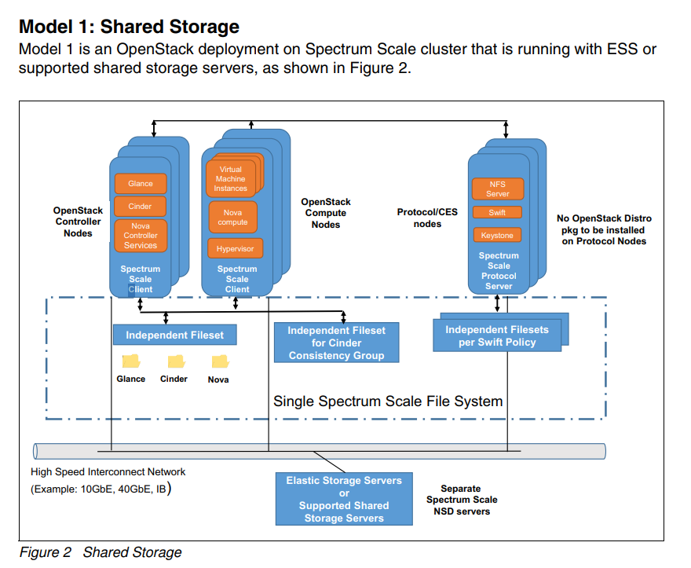
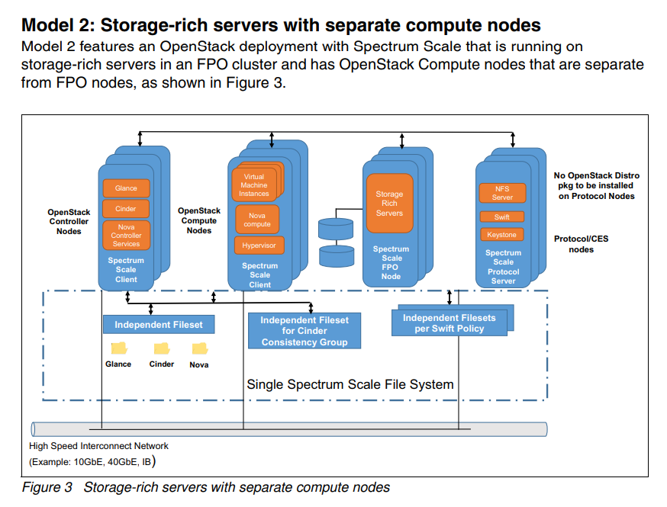
Notes:
https://www.redbooks.ibm.com/redpapers/pdfs/redp5331.pdf

Slide 11
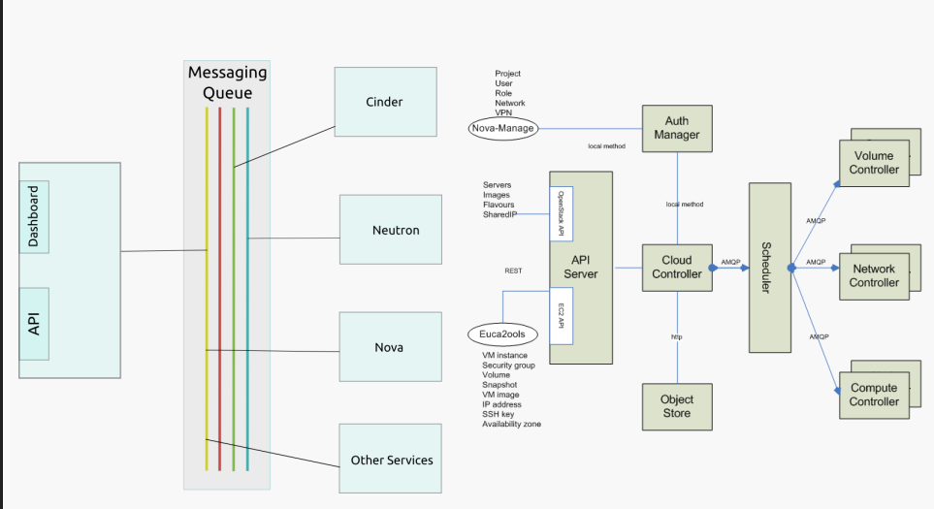
Notes:
https://www.tmit.bme.hu/sites/default/files/CloudNet_EN_2017_05_OpenStack.pdf
https://docs.openstack.org/kolla-ansible/train/reference/storage/manila-guide.html

Slide 12
New Ref
https://github.com/cybermnemosyne/cits5503
AWS
https://www.tmit.bme.hu/sites/default/files/

Slide 13
https://github.com/cybermnemosyne/cits5503
CITS5503 Cloud Computing
This unit introduces cloud computing as the provision of computing resources. Students are exposed to modern systems architectures and software development kits that, together, provide cloud computing frameworks. Students will learn about different aspects of the design, development, provisioning and management of cloud-based applications.
Students will gain a sound understanding of cloud-based computing and the opportunities that it provides for a diverse range of computing applications. Special attention will be made to security of cloud based applications and the different strategies that are available in these deployments.
An overarching goal of the unit is to provide students with an opportunity to undertake problem identification, analysis and solution and to apply these skills to the field of Cloud Computing.
Note on the use of AWS
The course is based on the cloud services of Amazon Web Services and a range of open source and other products. It is not possible in a course such as this to cover all of the products that these cloud services provide. The theme has been to concentrate on the most common use cases of [a] using AWS to deploy web applications utilising data sources such as databases and [b] data analytics and machine learning.
Learning Outcomes
Students are able to
Understand cloud services, there motivation, design and implementation
Understand the basics of virtualisation of hardware, networks and security
Understand application architectures and how they meet specific requirements and needs
Understand how to achieve scalability and security in a cloud-based architecture
Use DevOps to deploy and manage the creation and updating of software environments
Use cloud services to carry out specific use cases such as data analytics, machine learning and other artificial intelligence tasks
Write code in Python using a variety of SDKs to achieve the above where appropriate
Contents and Assessments
The course consists of 12 weeks of lectures and 10 weeks of practical lab classes (2 points each). Assessment is through a midsem exam and a final exam.
20% Labs
30% MidSem Exam
50% Final Exam
Reading List
Lectures
For Labs cilck here.
Introduction to Cloud Computing - CITS5503
Intro to Cloud Computing (Week 1)
Week 1
Motivation for cloud computing, introduction to cloud computing
Content
CloudComputingIntro (pptx)
Previous Lecture Recording (2019): Video
WhatIsTheCloud (pptx)
Previous Lecture Recordings:
2019 - part 1: Video
2019 - part 2: Video
Assignments (MidSem Exam)
Week 1: 4 Questions
Week 2
Cloud Computing and AWS: Introduction to AWS platform and services, awscli command line and python boto programming interfaces
Content
Lecture Recording 2021 Week 2
AWSIntro (pptx)
Previous Lecture Recording (2019): Video
AWS Guest Lecturer (2020): Video
Boto (pptx)
Assignments (MidSem Exam)
Week 2: 2 Questions
Week 3
Computer virtualisation. Background and different approaches. Containers and Docker
Content
Lecture Video 2021 - Week 3
Assignments for week 3 Available
Virtualisation (pptx)
Previous Lecture Recordings:
2020: Video
2019: Video
Lab 2 Recording 2021- EC2, Boto3, Docker
Assignments (MidSem Exam)
Week 3: 2 Questions
Week 4
AWS storage EBS, S3, DynamoDB
Content
AWS Storage (pptx)
Previous Lecture Recordings:
S3 (2019): Video
DynamoDB (2019): Video
2020: Video
Lab 3 Recording - S3 and DynamoDB
Assignments (MidSem Exam)
Week 4: 4 Questions
Week 5
AWS security and identity management
Content
Lecture Video 2021 - Week 5
IAM (Identity Access Management) (pptx)
Previous Lecture Recording:
2019: Video
2020: Video
Lab 4 Recording - Policies and KMS
Assignments (MidSem Exam)
Week 5: 3 Questions
Week 6
Networking, IP addressing, subnets, routing virtual private clouds
Content
Networking (pptx)
Previous Lecture Recording (2018):
Networking Fundamentals: Video
NAT (Network Address Translation): Video
ELB (Elastic Load Balancing): Video
Lab 5 Recording - Load balancers
Assignments (MidSem Exam)
Week 6: 2 Questions
Week 7: Study Time Week
There will be no scheduled labs or content for lectures and the time can be used for completing the pending labs.
Week 8
Web architectures using python as a model with RDBMS
Content
WebArchitecture (pptx)
Previous Lecture Recordings:
2018:
Web Architecture: Video
Django Demo: Video
SQS Video: Video
2020: Video
2021: Video (Apologies for the audio issues in the first 20 minutes)
Lab 6
Assignments (MidSem Exam)
Week 8: 2 Questions
Week 9
Software controlled deployment of services and software using Chef
Content
DevOps (pptx)
Previous Lecture Recordings:
2018:
OpsWorks Chef: Video
DevOps Intro Fabric: Video
Code Build Demo: Video
2020: Video
Lab 7
Assignments (MidSem Exam)
Week 9: 2 Questions
Week 10
Machine learning using classification and categorisation services
Content
AI (pptx)
Previous Lecture Recordings:
2018:
AI: Video
AI + ML Demo: Video
2020: Video
Lab 8
Assignments (MidSem Exam)
Week 10 (final): 1 Question
Week 11
More AI services including text analysis, image analysis, chatbots and data analysis using Jupyter and SageMaker
Content
MoreAI (pptx)
Previous Lecture Recordings:
2018:
More AI Intro Video
Chatbots Video
SageMaker Video
SageMaker Demo Video
2020: Video
Lecture AI 2021
Lab 9
Week 12
Mobile application integration and services and IoT integration using cloud services
Content
MobileIntegration (pptx)
Previous Lecture Recording (2018):
Mobile: Video
Mobile Demo: Video
Lecture Final Exam
Labs
For Lectures cilck here.
This semester all labs will be assessed as "Lab notes". You should follow all steps in each lab and include your own comments. In addition, include screenshots showing the output for every commandline instruction that you execute in the terminal and any other relevant screenshots that demonstrate you followed the steps from the corresponding lab. Please also include any bash or python script that you create and the corresponding output you get when executing it. Please submit a single PDF file. The formatting is up to you but a well organised structure of your notes is appreciated.
Week 1
No Labs for Week 1.
Week 2 (Lab 1)
Instructions: Lab1 Intro and setup of environment
Week 3 (Lab 2)
Instructions: Lab2 EC2 and docker
Week 4 (Lab 3)
Instructions: Lab3 S3 and DynamoDB Creating CloudStorage application
Week 5 (Lab 4)
Instructions: Lab4 IAM, KMS and AES encryption
Previous Recordings (2020): Lab Video
Week 6 (Lab 5)
Instructions: Lab 5 Networks and VPC
Previous Recordings (2020): Lab Video
Week 7
No labs this week to make up for the assignment
Week 8 (Lab 6)
Instructions: Lab 6 Web applications, Django and ELB
Previous Recordings (2020): Lab Video
Week 9 (Lab 7)
Instructions: Lab 7 DevOps
Previous Recordings (2020): Lab Video
Week 10 (Lab 8)
New Lab 8 (2021 version - SageMaker)Lab Instructions
Lab 8 (Old - AWS ML Deprecated): Lab 8 Machine learning using classification and categorisation services
Previous Recordings (2020): Lab Video
Week 11 (Lab 9)
Instructions: Lab 9 More AI: Text analysis, image analysis, chatbots
Previous Recordings (2020): Lab Video

Slide 14
https://compas.cs.stonybrook.edu/cse356-v3
https://compas.cs.stonybrook.edu/~mferdman/#teaching

